Slide 1

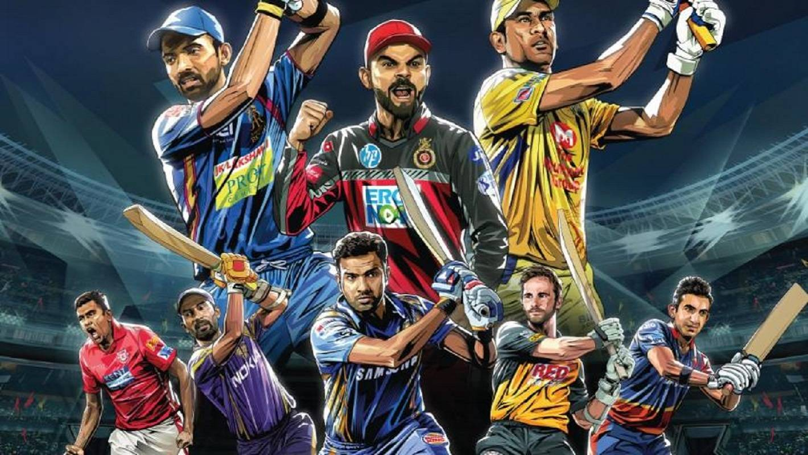
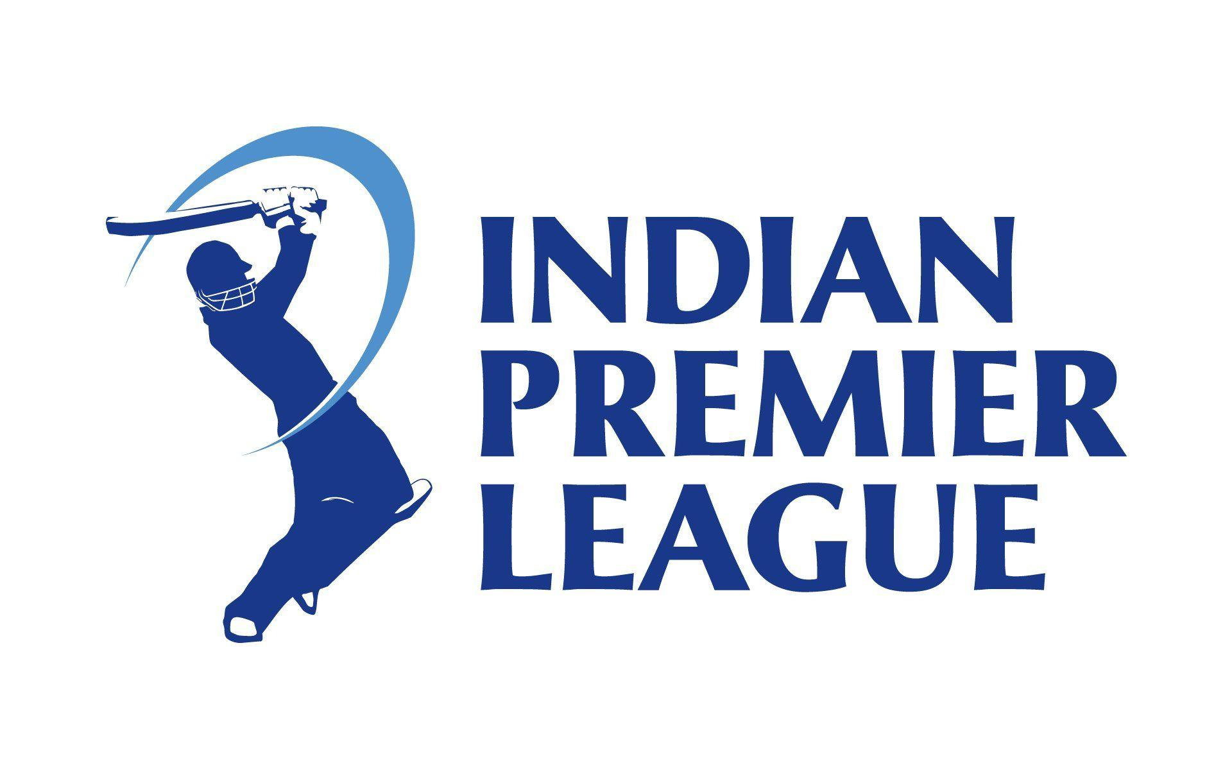
Human resources slide 1
EDA IPL (2008 -18)
Narendra Singh Parihar
Jan’2020 Batch

Slide 2
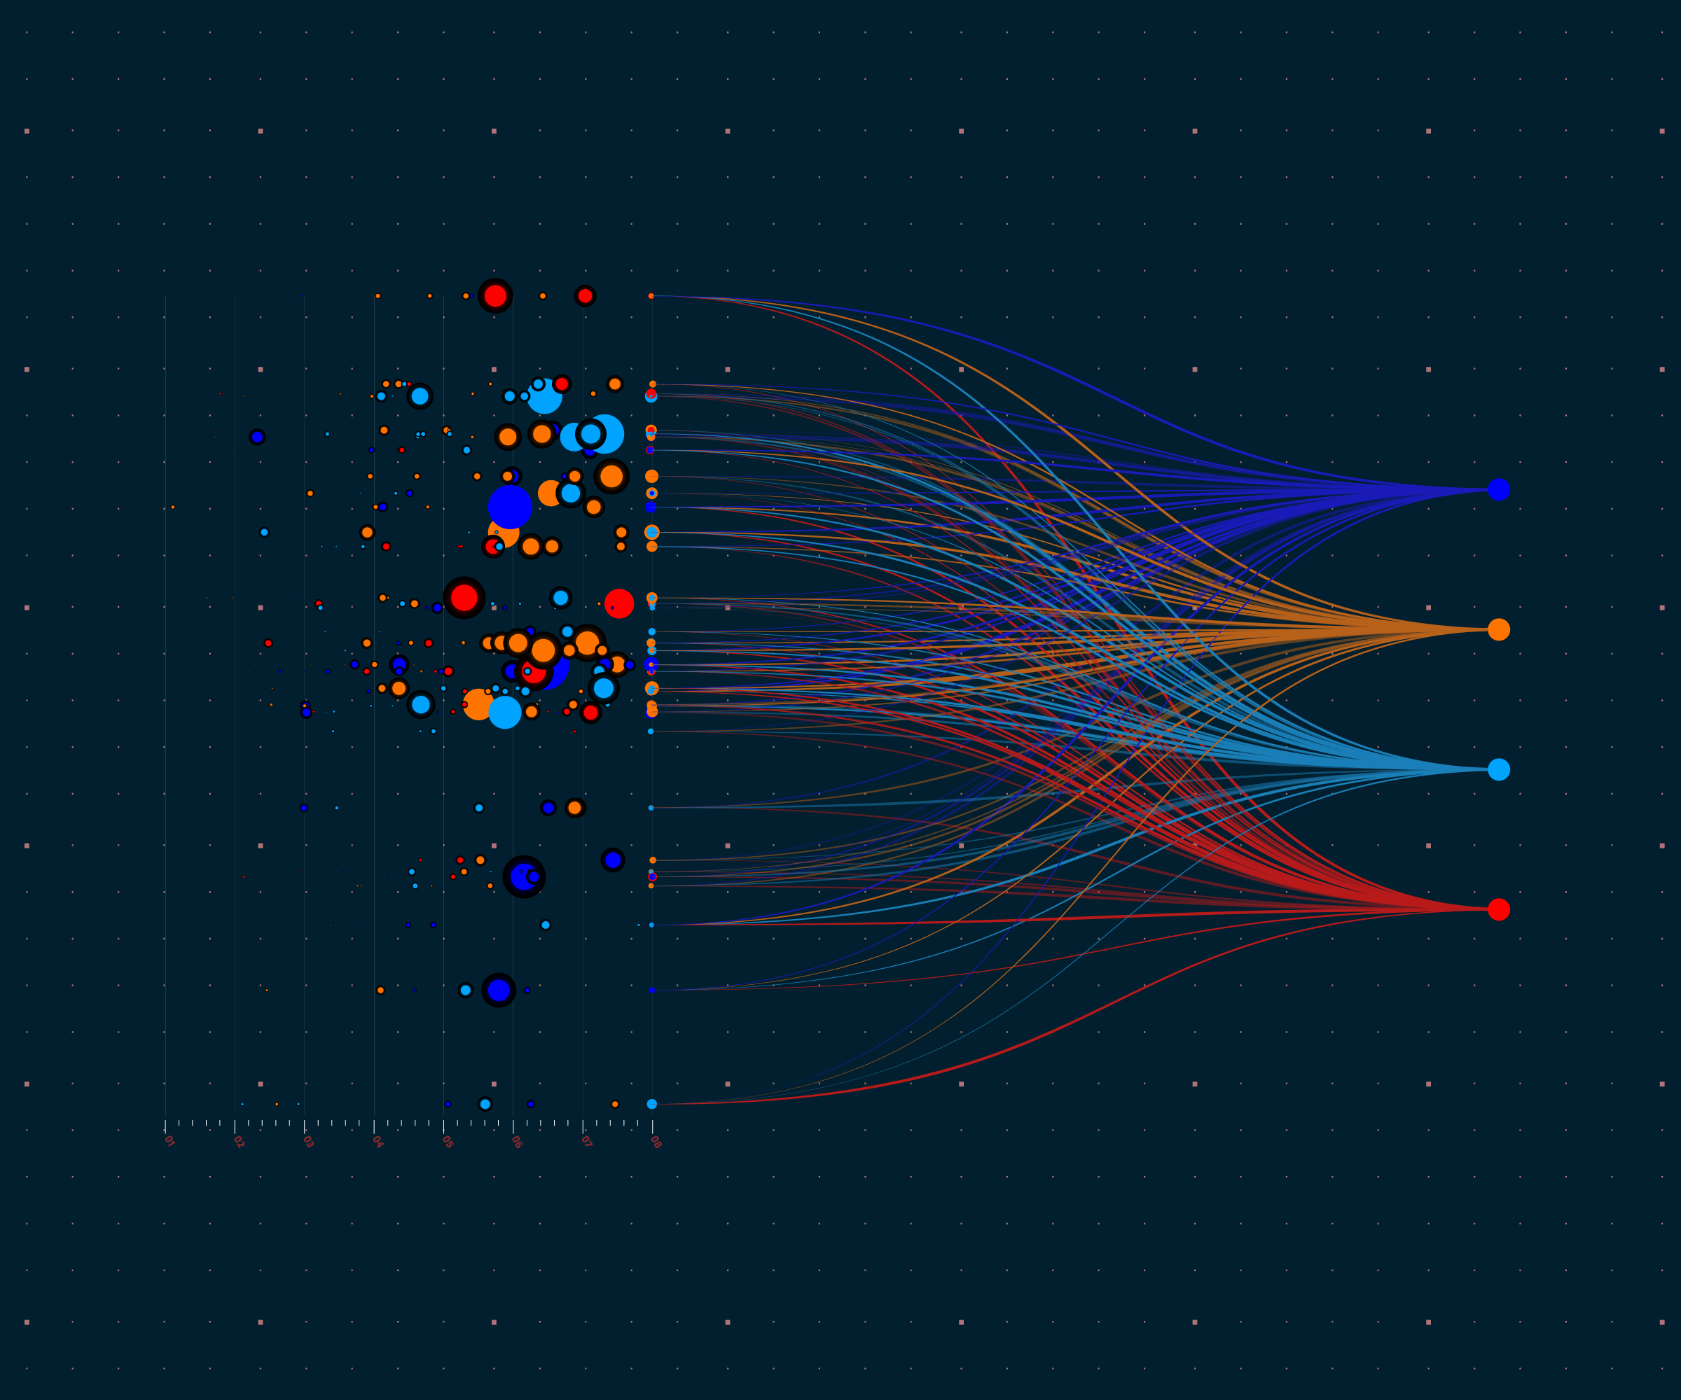
Human resources slide 2
AGENDA
Case Study and EDA Objective
Dataset Observations
Data Analysis
Conclusion

Slide 3

Human resources slide 3
CASE STUDY
&
EDA OBJECTIVE
The case study consist two datasets : -
EDA Objective :
This Exploratory Data Analysis is done to practice Python skills learned till now on a structured data set.
The key actions as part of EDA are loading, inspecting, wrangling, exploring, and drawing conclusions from data.
Based on the observation some questions (as mentioned in next slide ) are answered, though not all of them are explored in the analysis.
IPL Matches Data set – matches.csv
Match level data from 2008 to 2018.
There are total 696 rows and 18 columns.
IPL Deliveries Data set – deliveries.csv
Ball by ball data of all matches from 2008 to 2018
There are total 164750 rows and 21 columns
Case study contains data of IPL Matches played from 2008 to 2018.

Slide 4


Human resources slide 4
Analysis of Home ground advantage for teams ?
Total Runs Across the Seasons.
Is Toss Winner Also the Match Winner ?
Plot the performance of top batsmen & bowlers over seasons.
Explore several facts of IPL ?
Most match winning team of IPL till 2018 ?
Comparison of teams for knowing bettor performer of IPL.
Form 2008 to 2018,total match played by all teams and individual count ?
Analysis of All Finals team wise vs wins across all seasons
Questions ?

Slide 5
Human resources slide 6
DATASET - OBSERVATION
IPL MATCHES DATASET:
Match by match data from 2008 to 2018
Key column are : Match ID, Season, City, Team 1, Team 2, Toss Winner, Toss Decision, Winner, Player of Match, Venue.
There are total 13 teams, however not all played in every season.
Replacing the Team Names with their abbreviations as it is easy to recall and plot.
2011 had 10 teams, 2012 had 9 teams, 2013 had 9 teams, rest all years had 8 teams playing the tournament
7 matches ended in a tie, resulted in super over, 3 matches have no winner, maximum tosses and matches are won by Mumbai Indians and CH Gayle has been “Player of the match” maximum number of times.
Drop “umpire3” as it has 636 (91.4%) missing values.
Replacing missing values of “city” with Dubai as per venue details as these matches played at Dubai.
IPL DELIVERIES DATASET:
Ball by ball data of each IPL match played
Key columns are : Match ID, inning, batting/bowling team, over/ball, batsman, bowler etc.
The matches with super overs have innings 3 and 4
Its 20 over match and few overs have up to 9 balls per over, due to extra balls
Dealing with missing values in player_dismissed , dismissal_kind, fielder as these column have above 95% null values.

Slide 6

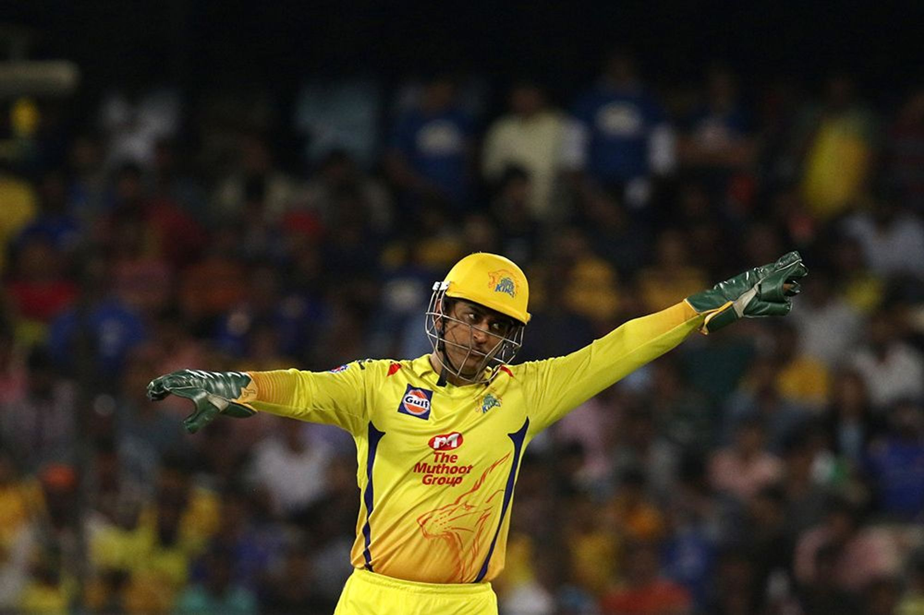
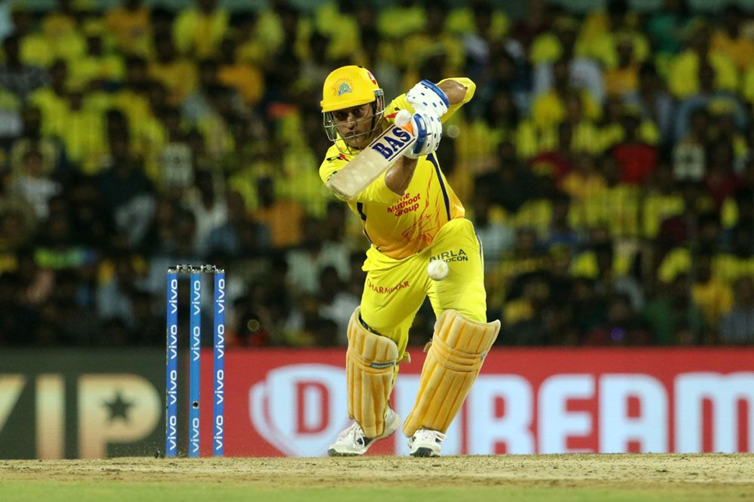
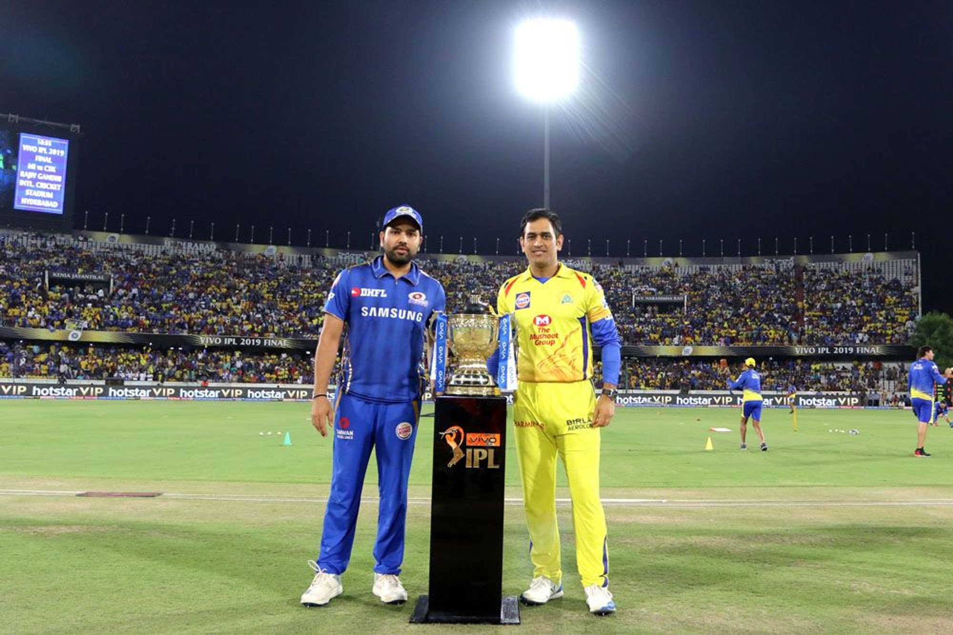
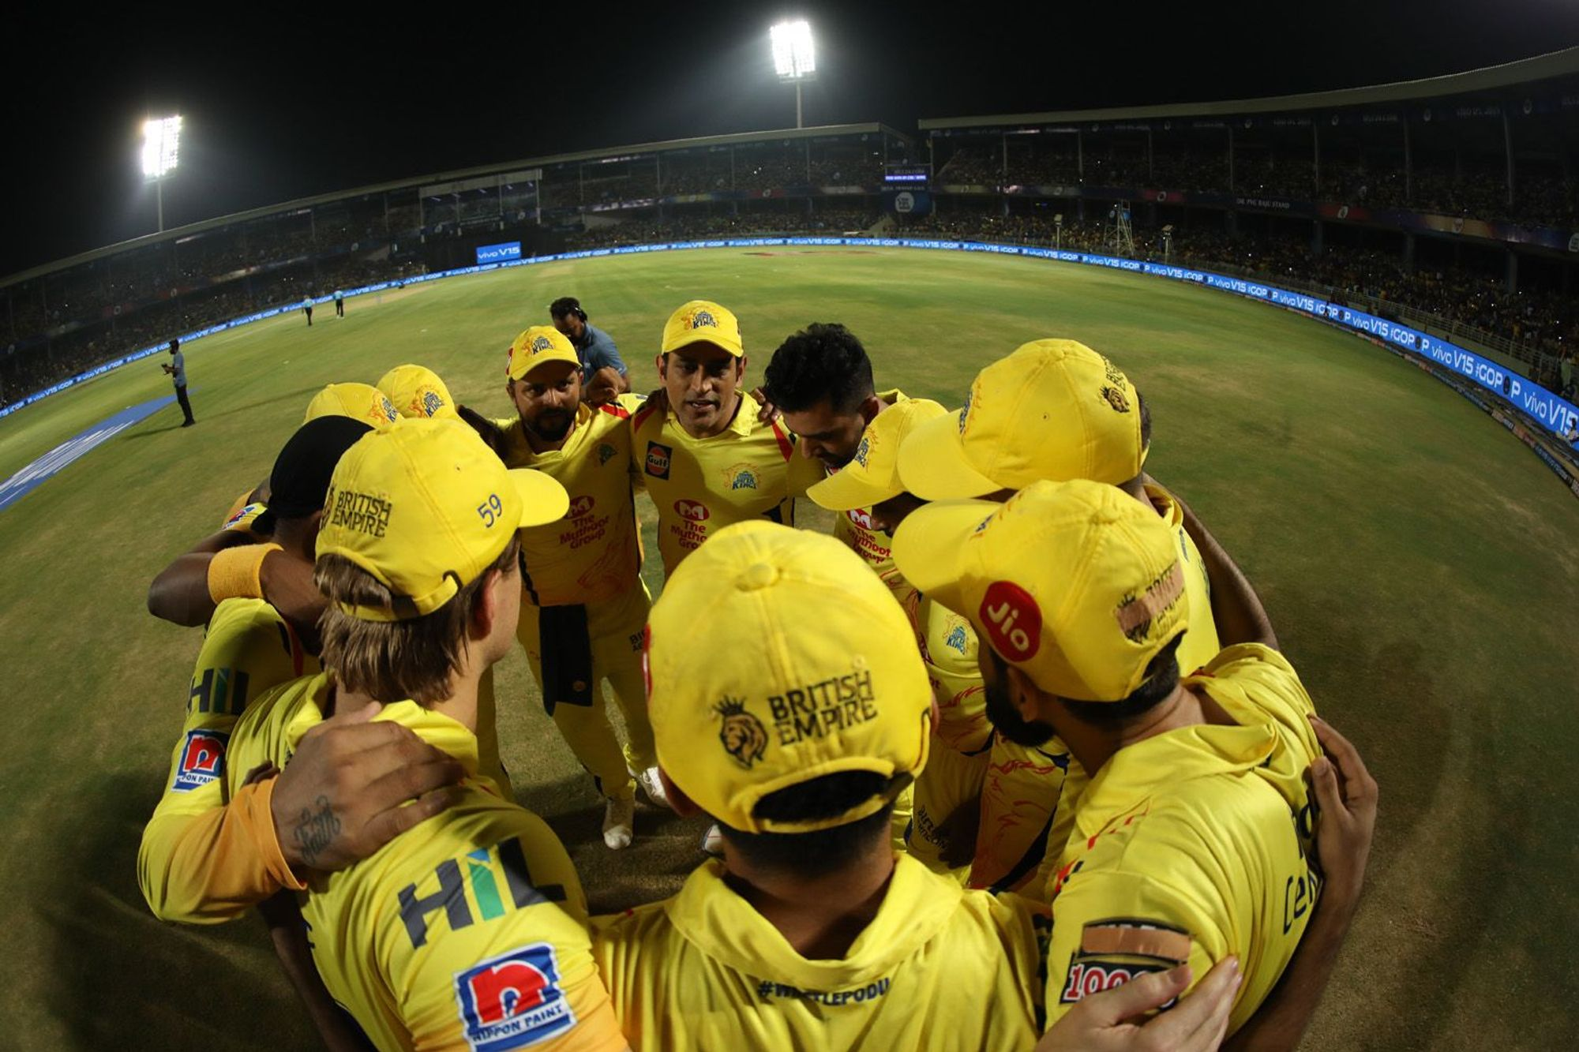
DATA ANALYSIS

Slide 7
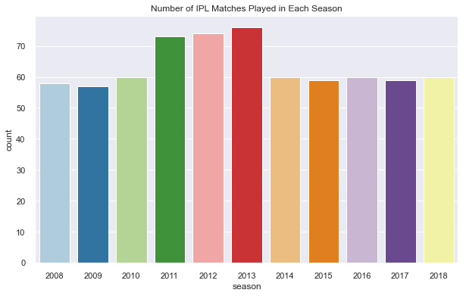
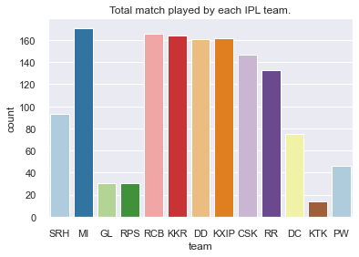
Form 2008 to 2018,total match played by all teams and individual count ?
In All seasons of IPL total 696 matches are played.
Number Of IPL teams – 8 teams played in each IPL, except in 2011 (10) and 2012,2013 (9).
Number of matches from 2011 to 2013 are more than during rest of the period due to more number of teams involved.
Number of matches played in 2013 (despite 9 teams playing) are 76, however 2011 had maximum 10 teams playing the tournament.
MI has played maximum 171 matches in 11 IPL seasons followed by RCB and KKR with 166 and 164 respectively.
KTK has played minimum 14 matches.

Slide 8
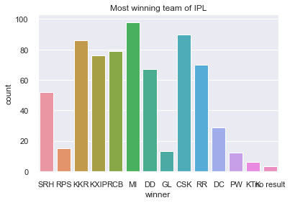
Most match winning team of IPL till 2018 ?
MI is most match winning team of IPL with 98 match wins and KTK won least matches , only 6 matches as KTK played only 14 matches.
CSK is second most match winning team with 90 match wins whereas CSK is 6th team in highest match playing list.

Slide 9
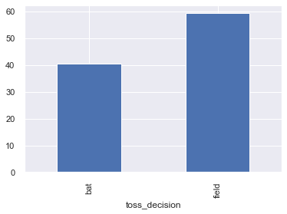
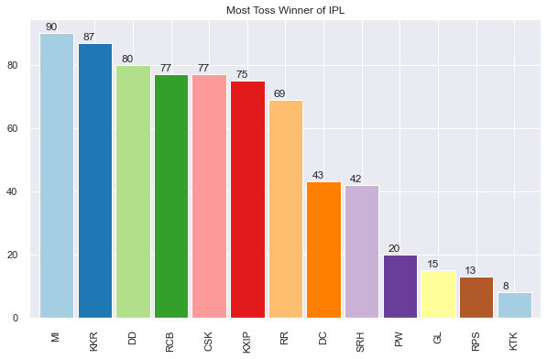
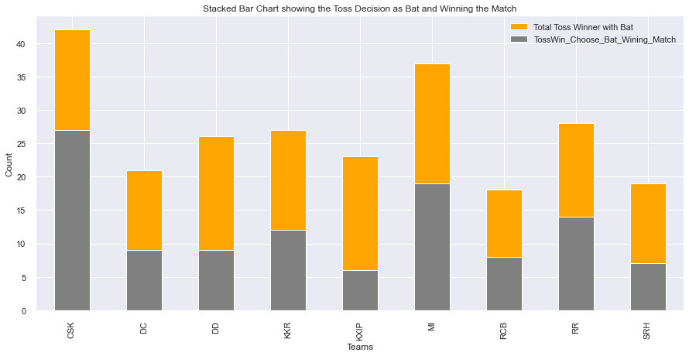
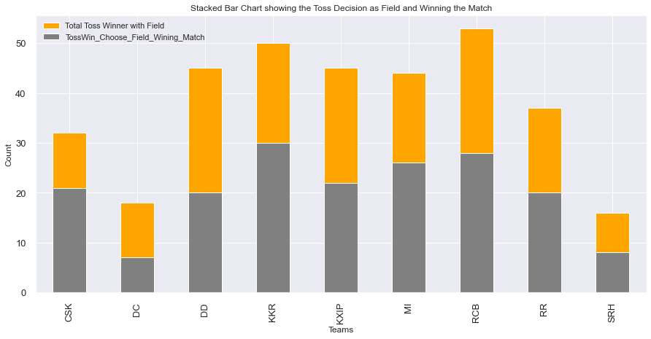
Explore several facts of IPL ?
CH Gayle won most awards of "Man of the Match" 20 times.
MI beat DD with the highest run difference of 146 in season 2017.
KKR conquered GL with the highest 10 wins by wickets.
In Toss decision teams prefer to choose around 60% field and 40% bat option.
MI is most toss winner followed by KKR.
Till 2018 ,CSK won 3 IPL Seasons and MI also won 3 IPL seasons followed by KKR with 2 IPL season wins.
In history of 11 season only 3 Teams are dominating more then others ,72% chances the winner should be from these 3 teams.
CSK has higher Toss winning with choose as batting first and winning the match in the end followed by MI.
KXIP has lowest winning after winning toss with choosing bat. In other words we can say KXIP has lost maximum matches in they won toss and choose bat first.
KKR has highest match winning after toss winning and choose fielding first in the end followed by RCB and MI.
DC has lowest winning after winning toss and choosing field. In other words we can say DC has lost maximum matches in they won toss and choose field first. The one reason is that DC play less match as it terminated from IPL and the this team introduced as SRH with new owner.

Slide 10
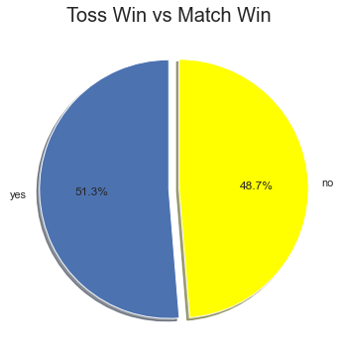
Is Toss Winner Also the Match Winner ?
From above plot we can say winning toss is not the guarantee of winning match.
MI is lucky to won maximum toss decision 90 times followed by KKR 87.

Slide 11
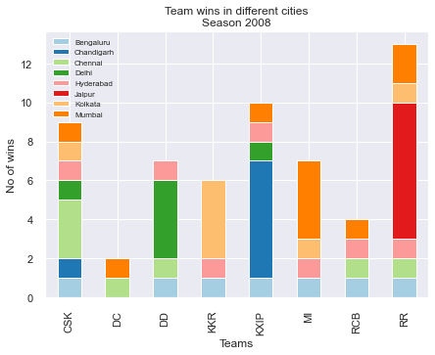
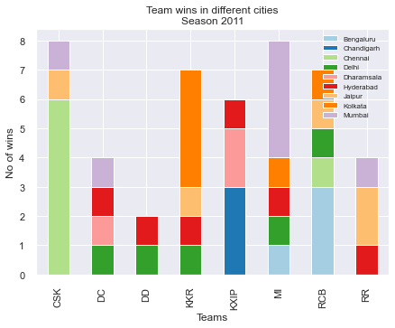
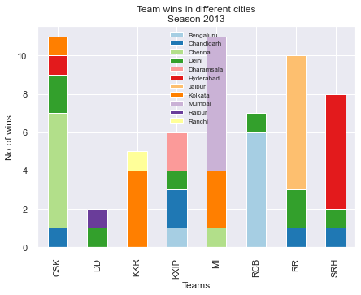
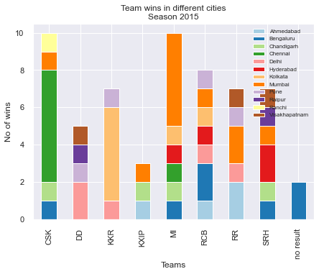
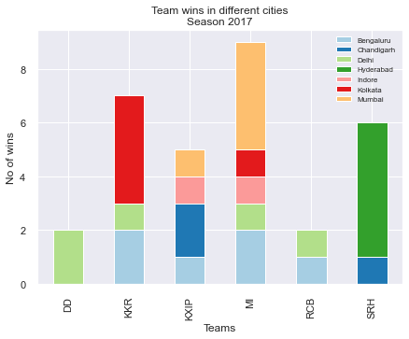
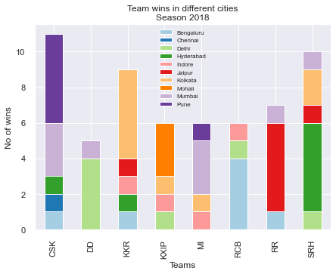
Analysis of Home ground advantage for teams ?
From looking above all plots we can say there is a home ground factor which also works as most of the teams win more matches at their home ground.

Slide 12
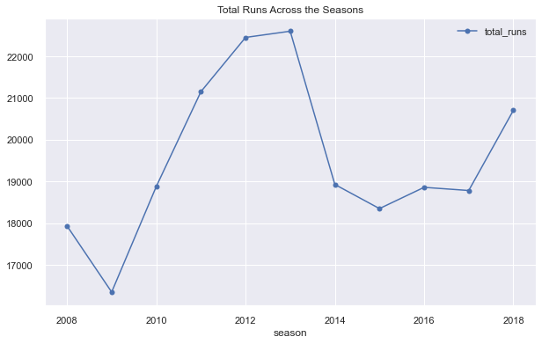
Total Runs Across the Seasons
2013 season has highest run across all season and 2009 season has minimum. There is a huge increase and decrease as number of matches are also not equal in all season. There are 9 teams playing in 2013 season.
2009 season has huge decrease in runs because one reason may be that all matches of 2009 are played at South Africa.
2014 season has also huge decrease in runs because 33% matches of this season are also played at Dubai and Abu Dhabi.

Slide 13
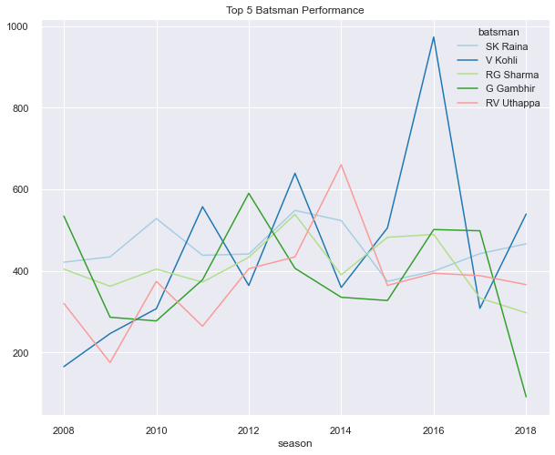
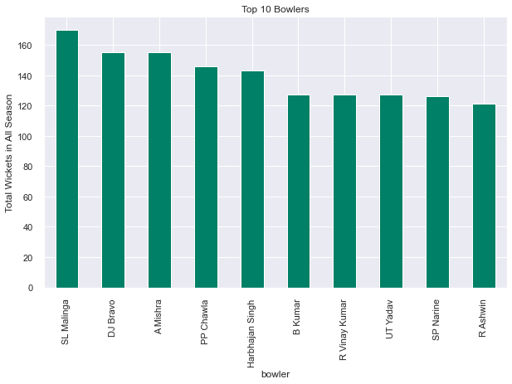
Plot the performance of top batsmen & bowlers over seasons
Virat Kohli show a steady improvement across season and RG Sharma and G Gambhir show a slump.
SL Malinga is the highest wicket(170) taker in IPL so far.

Slide 14
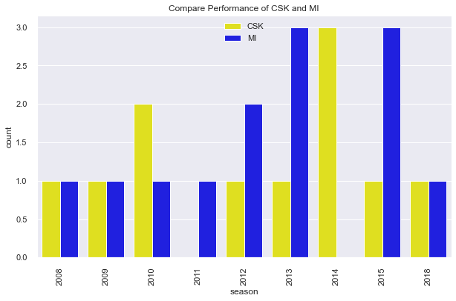
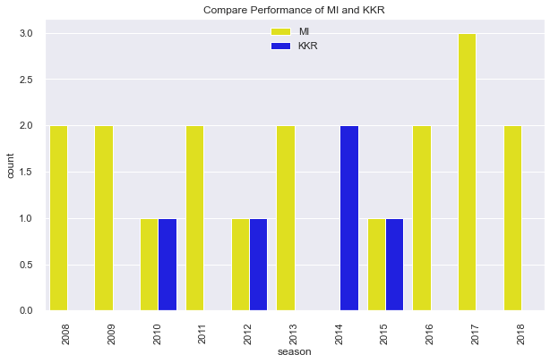
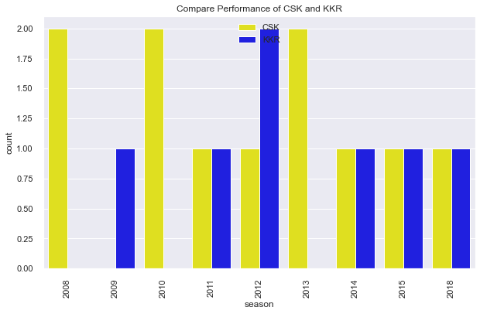
Comparison of teams for knowing bettor performer of IPL.
Overall MI has a great performance when compare to top 3 teams of IPL followed by CSK as CSK is out of IPL for 2 Season.

Slide 15
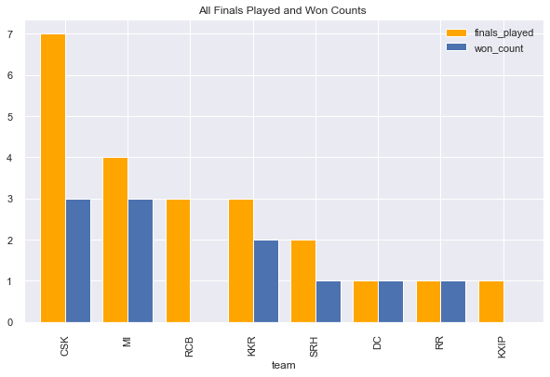
Analysis of All Finals team wise vs wins across all seasons
CSK has played 7 IPL finals but could win only 3 followed by MI with 3. KKR has won 2 titles. Sadly RCB have never won a final even with 3 appearance's in final. MI has high chances of winning if reached in final as it won 3 out of 4 finals.
From this we can say CSK has high changes to be in final in next season.
DD has not reached yet in any final match.

Slide 16
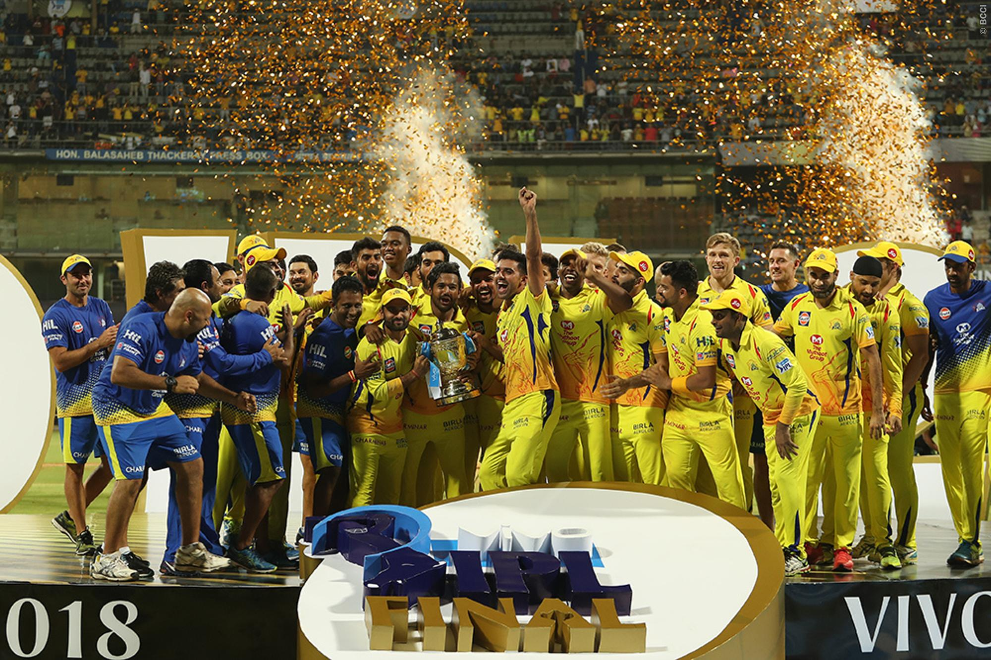
CONCLUSION

Slide 17
CONCLUSION
The most important inference drawn from all this analysis is, we get to know what are the features on which winning IPL is highly positively and negatively corelated with.
Selecting player who perform consistently is important for any IPL team to becomes a true champion.
Team selection should be more important as team should be a balanced as with batsman, bowlers and all rounders.
Number of Man of the Match titles are based on individual performances and does not necessarily help to perform best as a team Therefore team needs to give balanced weightage to players.
Toss winning is not guarantee of match winning. There is equal chances.
IPL season played out side INDIA has low total runs.
CSK has high changes to be in final in next season.

Slide 18
Human resources slide 10
Thank You

